Slide 1
Pharmacy management system
Supervised by: Mahammad humayoo
Presented By: Nekesh koju(770321)
Nischal baidar(770323)
Surag basukala(770346)

Slide 2
Topics Covered
Introduction
Key Features
Motivation
Objectives
Literature Review
Methodology
Tools and Platforms Used
Results and Discussion
Screenshots
Database Tables
Future Enhancements
Conclusion

Slide 3
Introduction
Software solution designed to automate various processes involved in the operation and management of a pharmacy or a retail pharmacy chain.
Following the CRUD operation our project is developed where the entities are Admin and User who doesn’t have equal access.
Integrates multiple functions and provides a centralized platform for managing activities related to inventory control, sales, customer management, and administrative tasks.
PMS
Create
Read
Update
Delete

Slide 4
KEY FEATURES
Pharmacy
Inventory Management
Billing
Drug Information

Slide 5
Motivation
To automate various tasks, such as prescription processing, inventory management, and billing
To reduces manual errors, speed up the process, and improves overall product management
To Improve the efficiency of product storing and updating data
To provide accurate and up-to-date information of products
To keep up with the changing needs and advancements in education technology

Slide 6
ObjectiveS
Develop user friendly Management System
Provide easy and efficient access to drugs for patients around the world.
Reduce manual workload

Slide 7
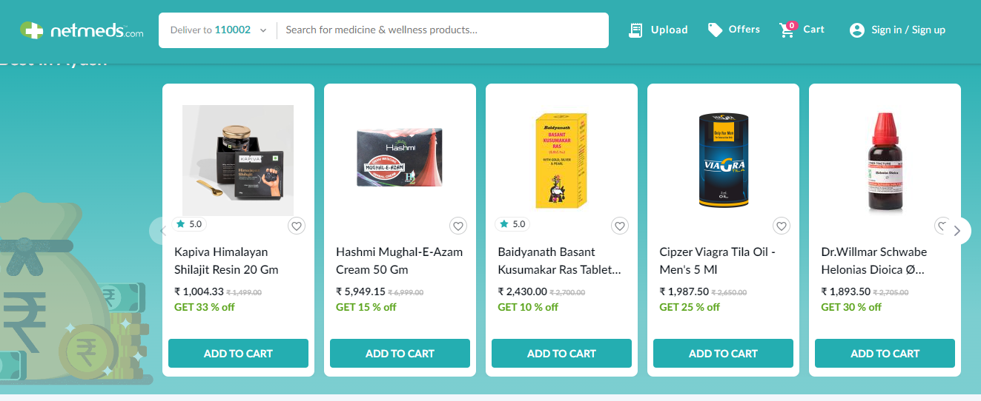
Literature Review
Inspired by NepMeds online pharmacy
Some more inspirations are Netmeds, ePharmacy, Pharmeasy, and Medlife, etc

Slide 8
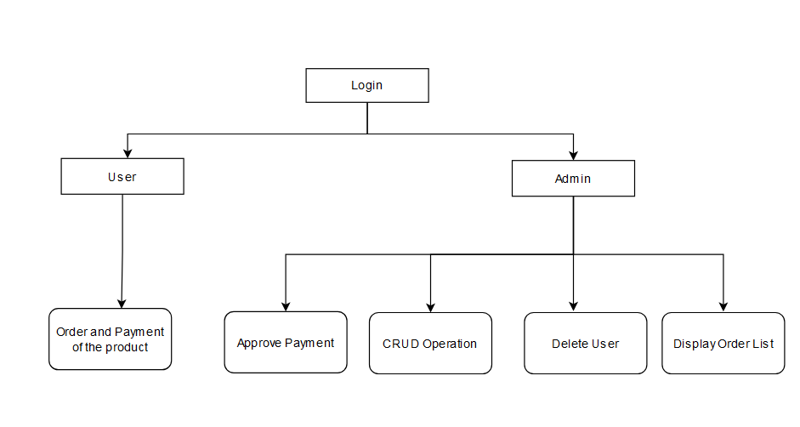
METHODOLOGY
1. Generic Model

Slide 9
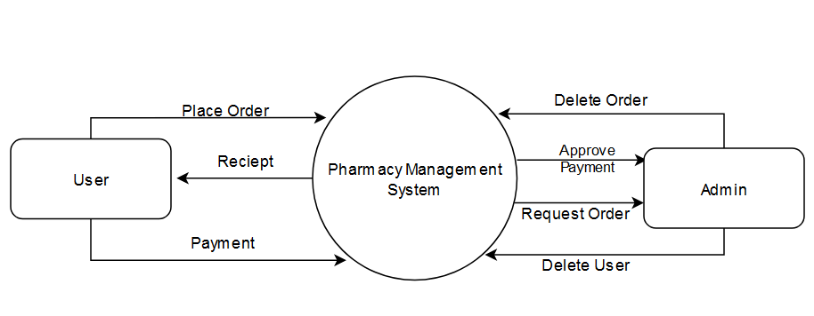
METHODOLOGY
2. Context Diagram

Slide 10
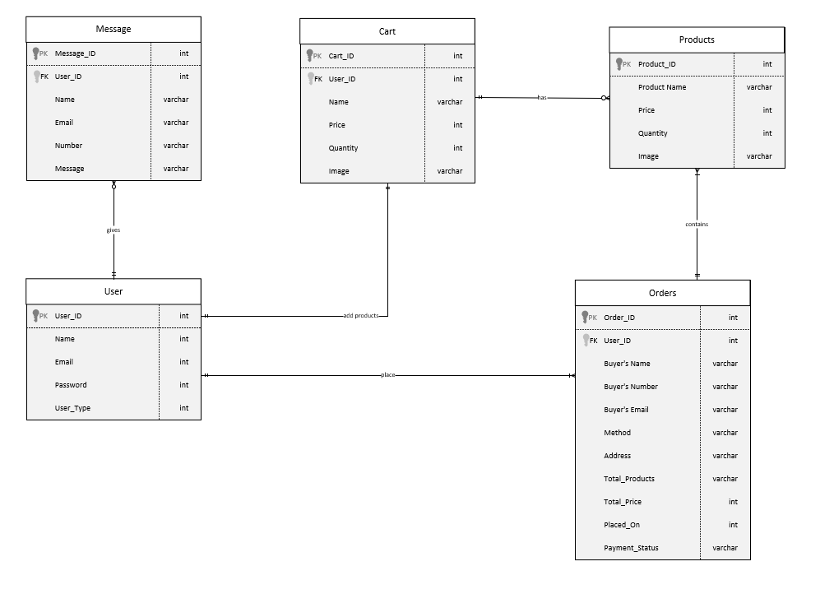
METHODOLOGY
3. Entity Relationship Diagram

Slide 11
Tools and Platforms Used
Operating System Used Windows
Language Used HTML, CSS, JavaScript, PHP, MySQL
Software Used VS Code, XAMPP

Slide 12
Results and Discussion
CRUD operation of products through admin
Admin can remove user’s and review user’s order
User can order products, add to cart
User can choose the method of payment
User can checkout product whenever he/she wants

Slide 13
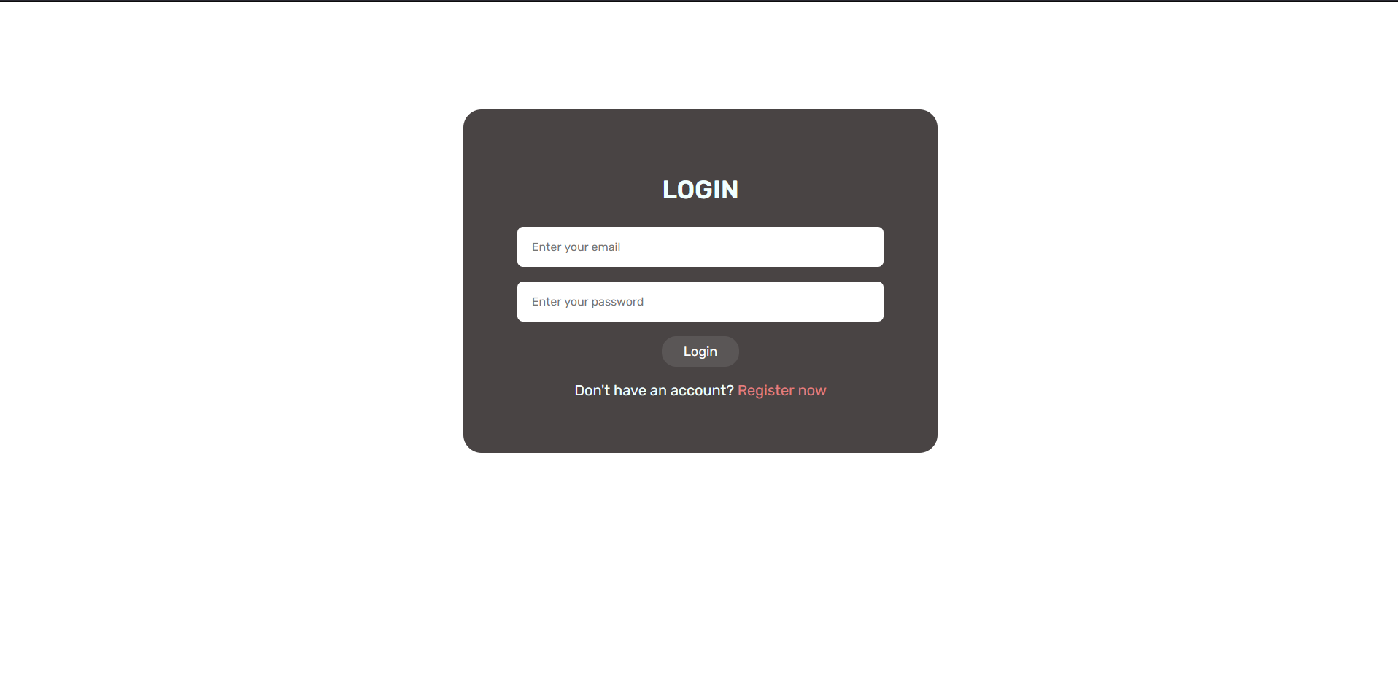
SCREENSHOTS

Slide 14
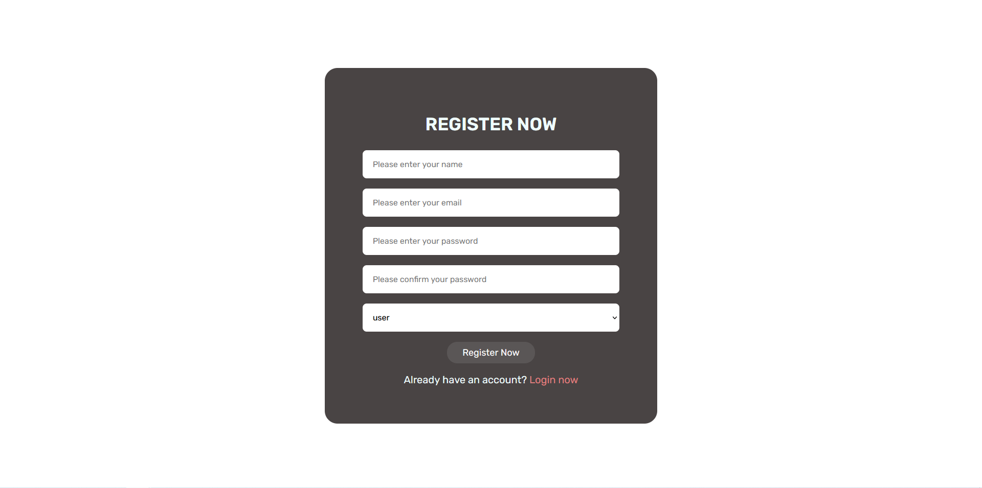

Slide 15
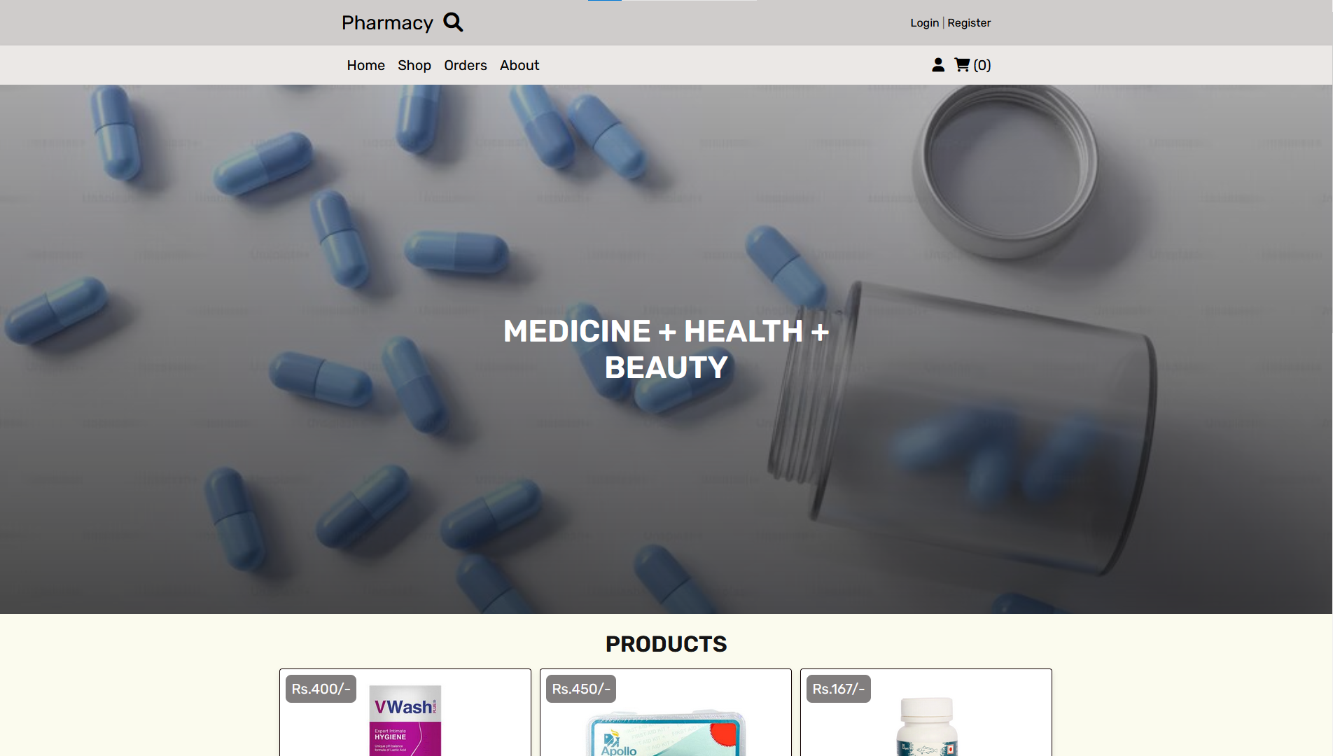

Slide 16
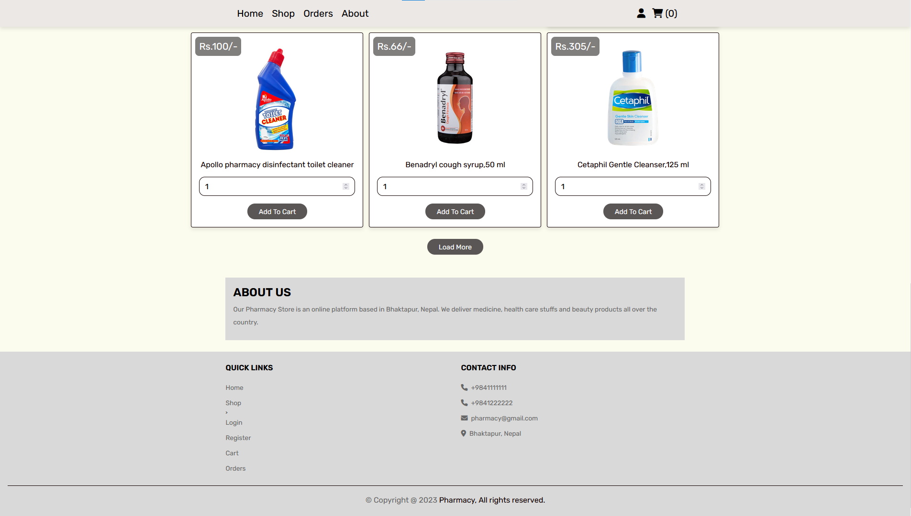

Slide 17
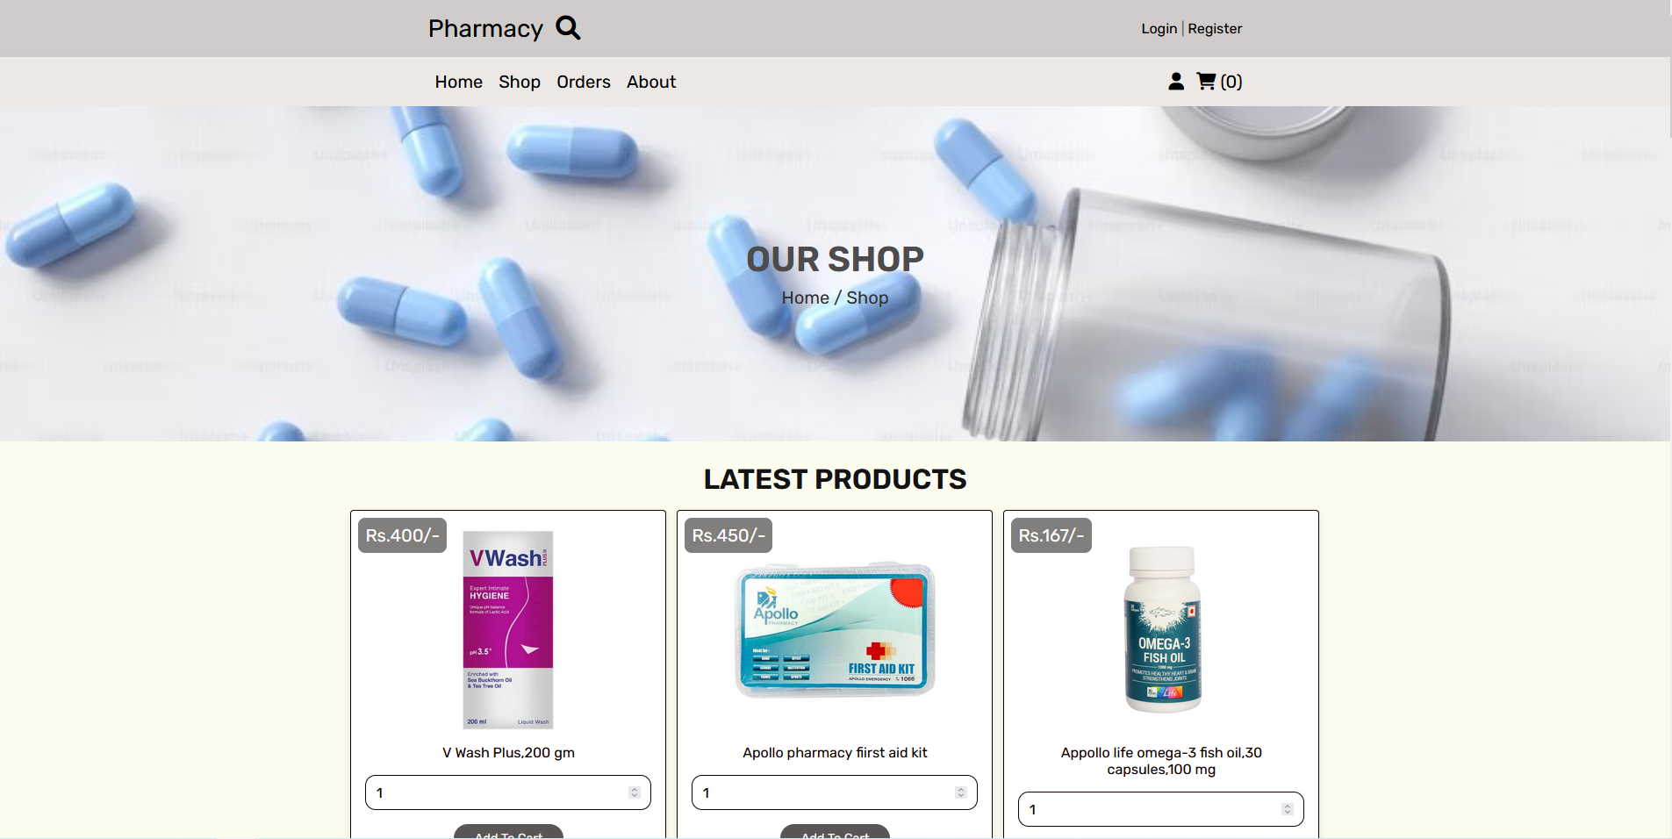

Slide 18
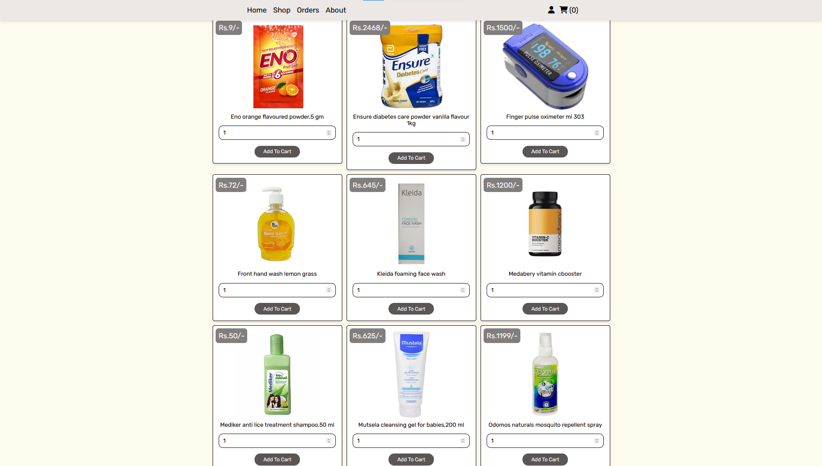

Slide 19
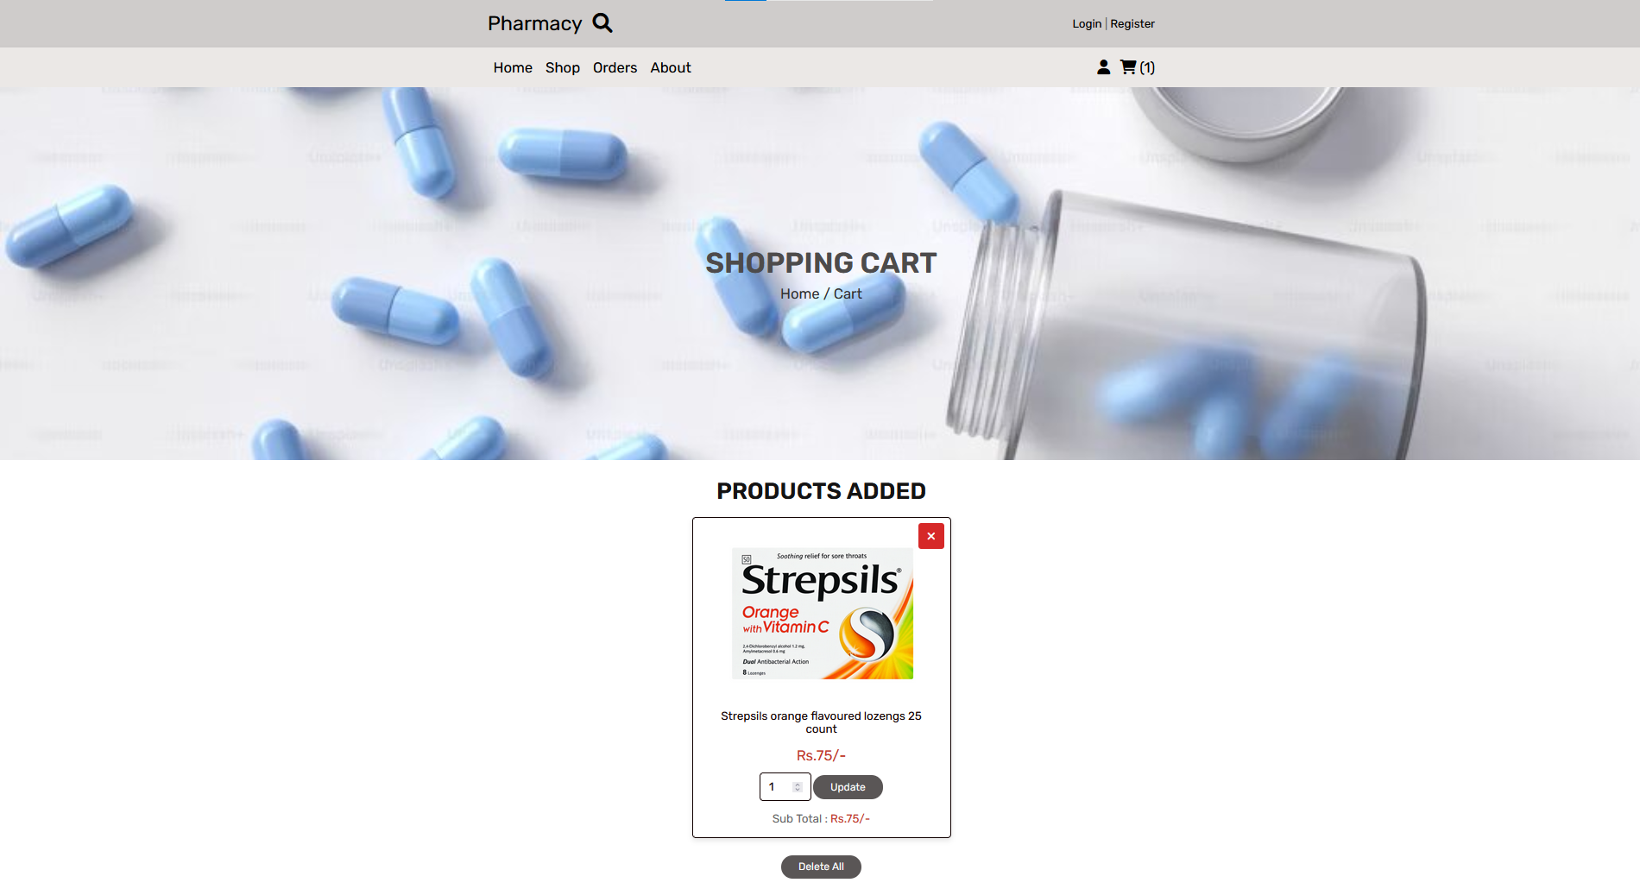


Slide 20
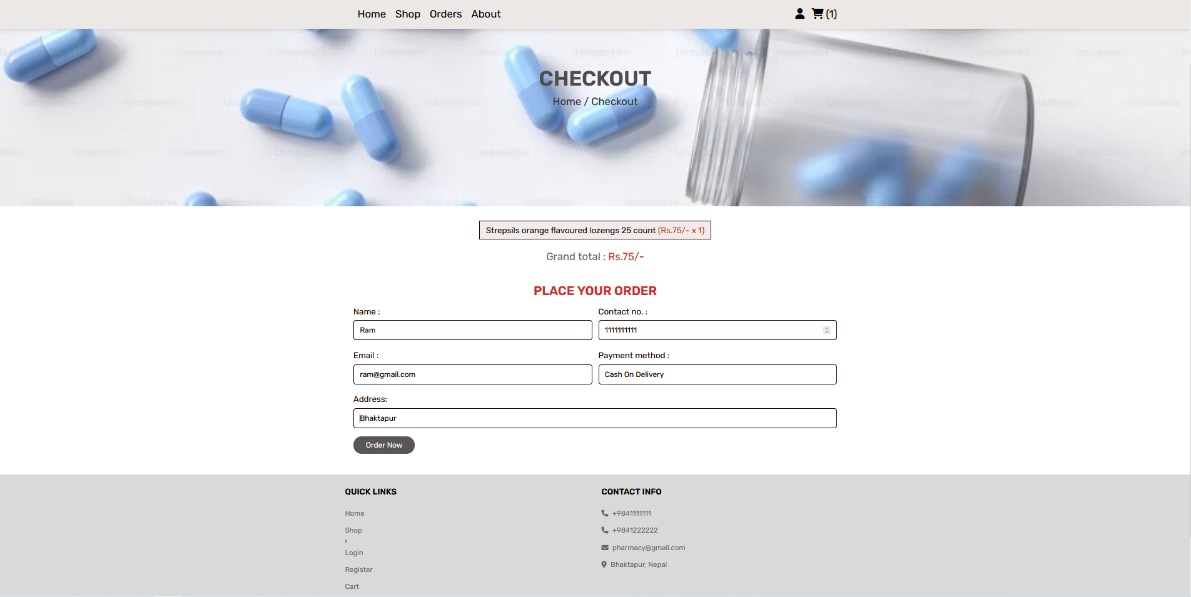

Slide 21
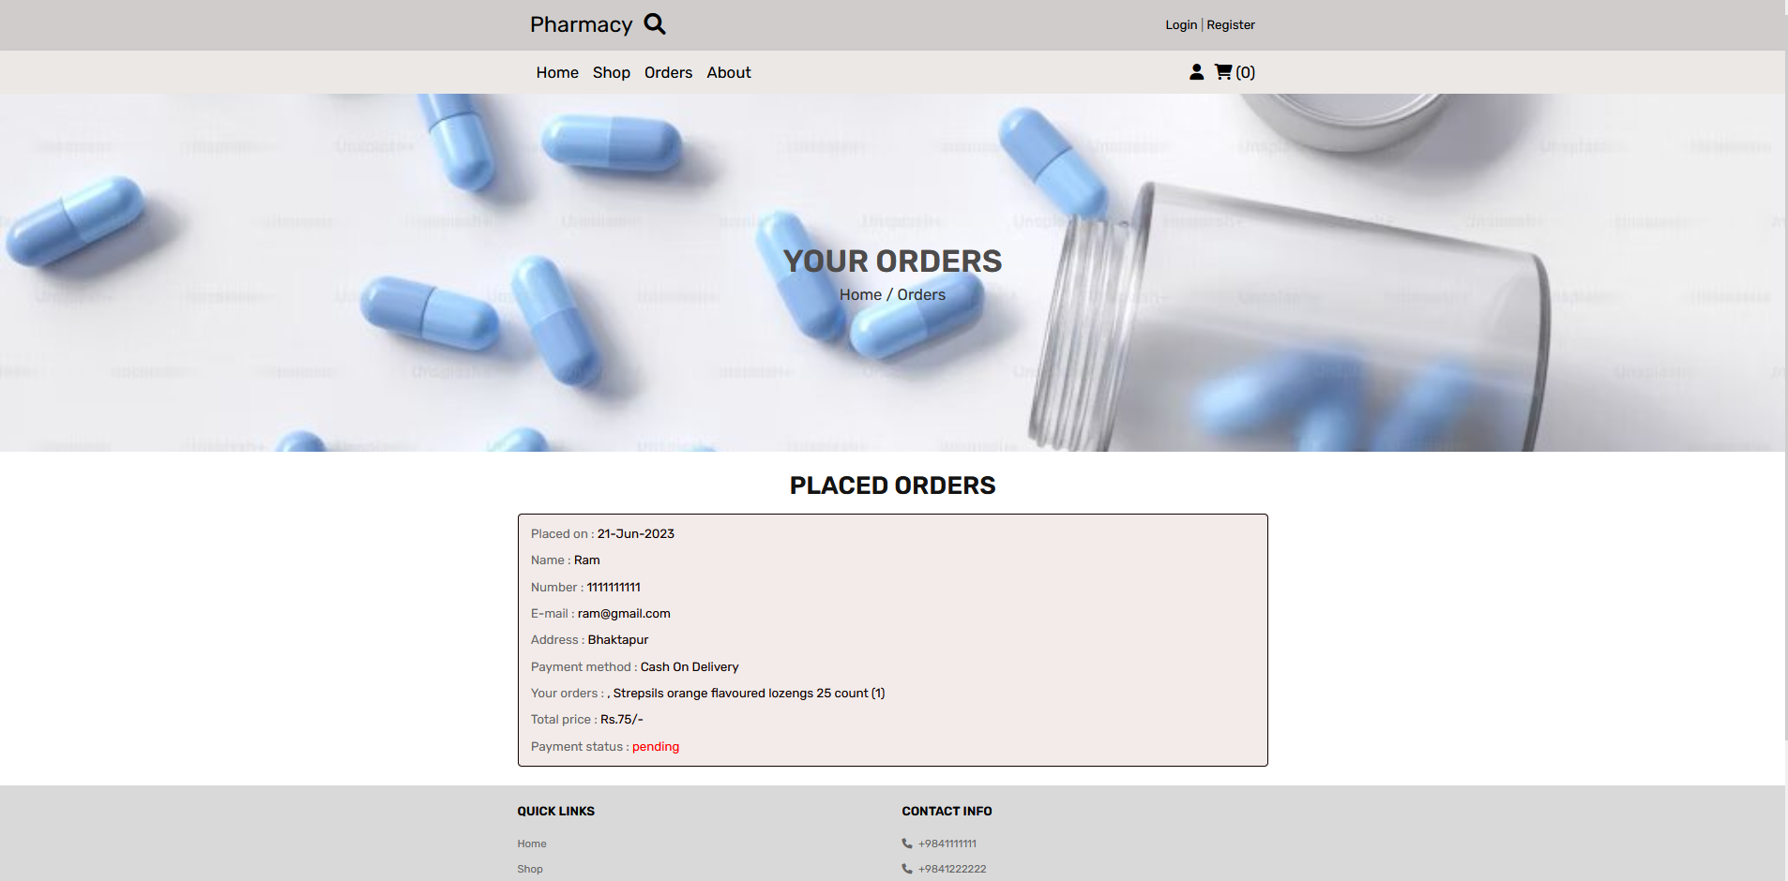

Slide 22
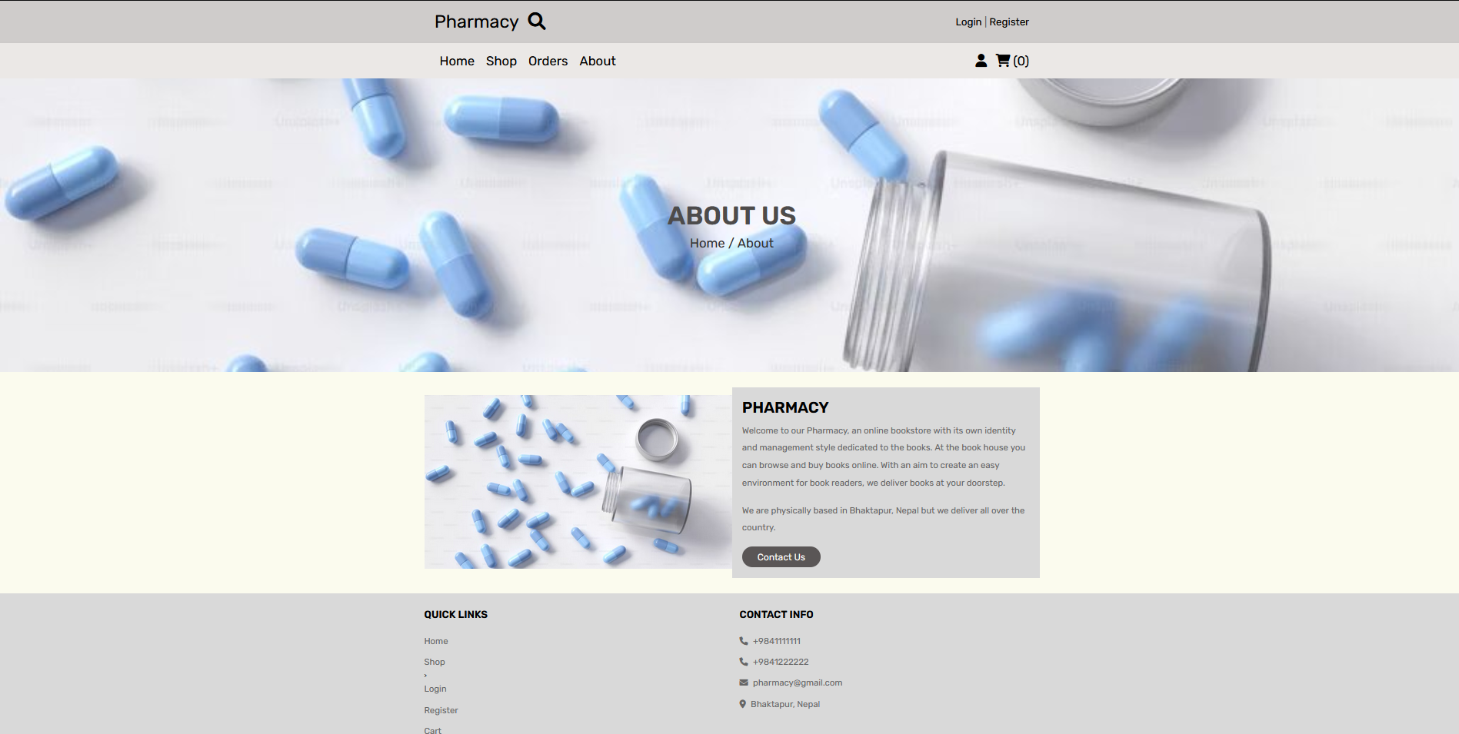

Slide 23
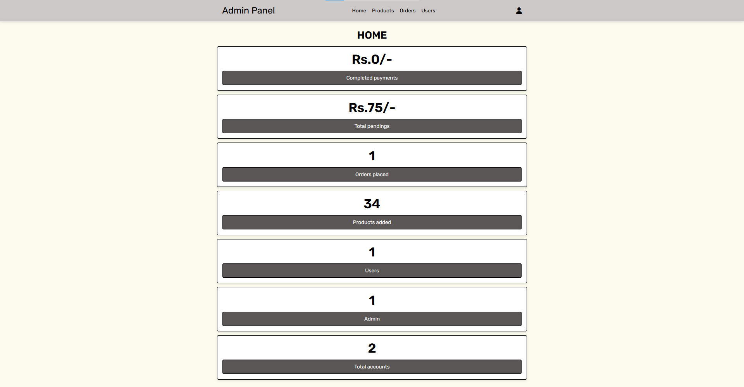

Slide 24
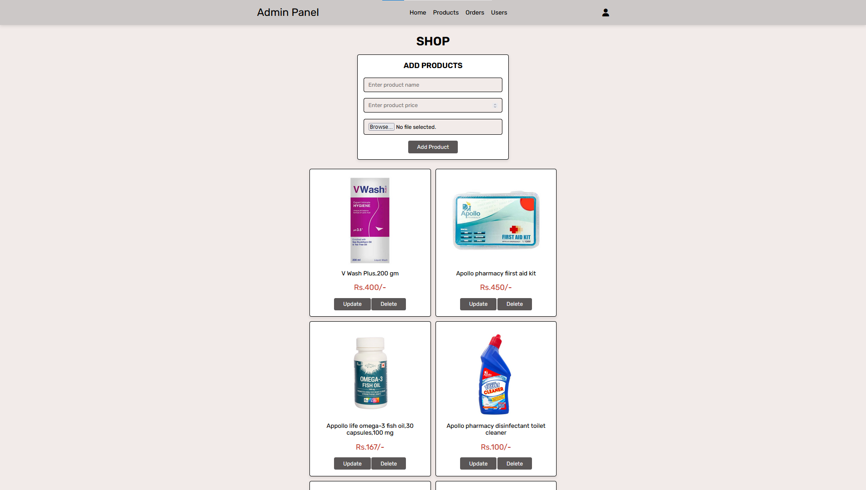

Slide 25
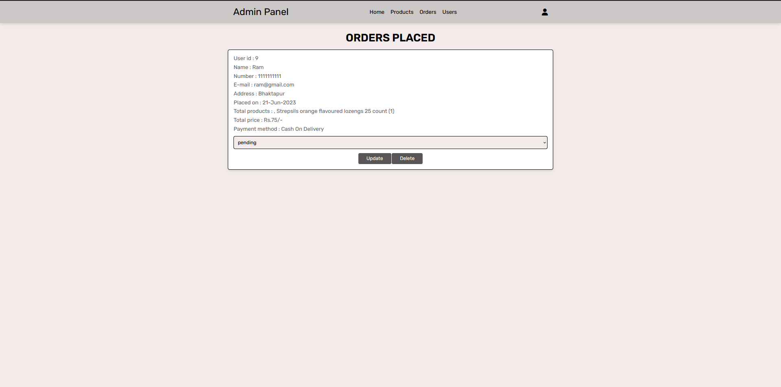

Slide 26
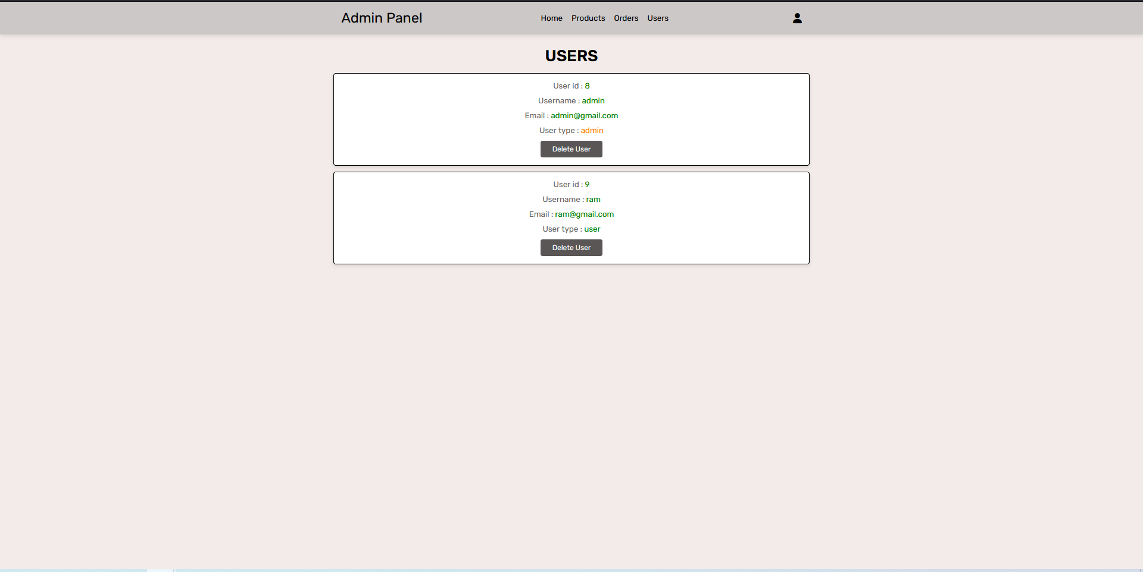

Slide 27
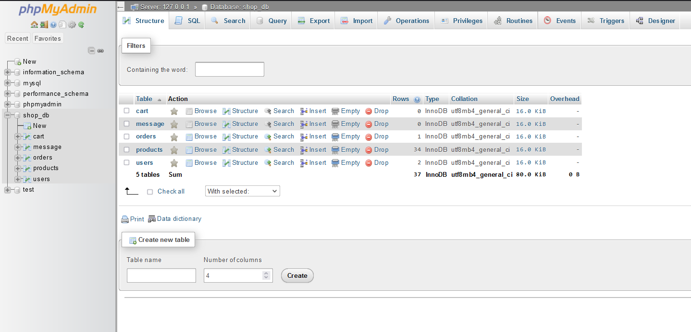
Database and tables

Slide 28
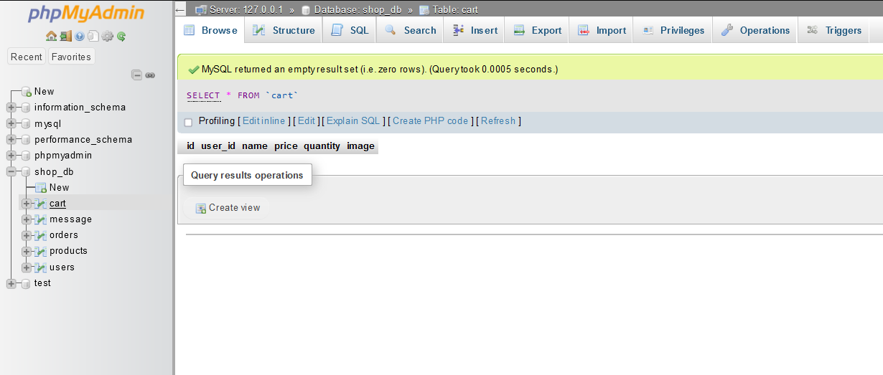

Slide 29
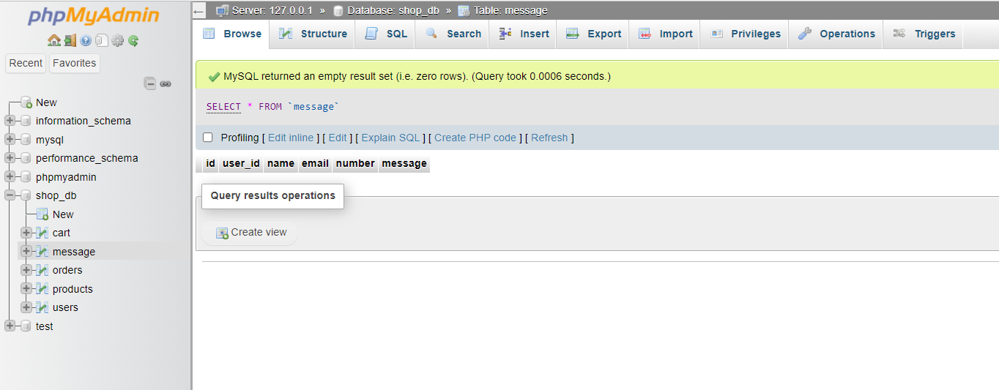

Slide 30
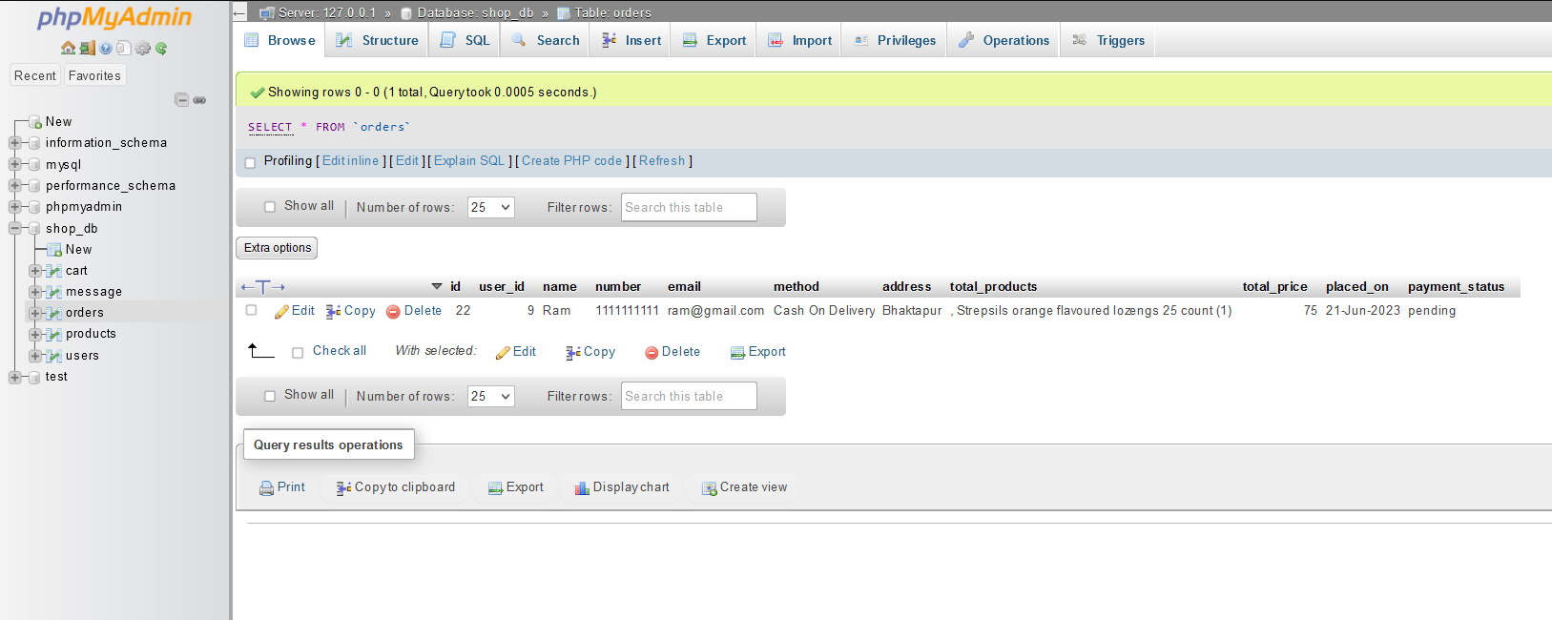

Slide 31
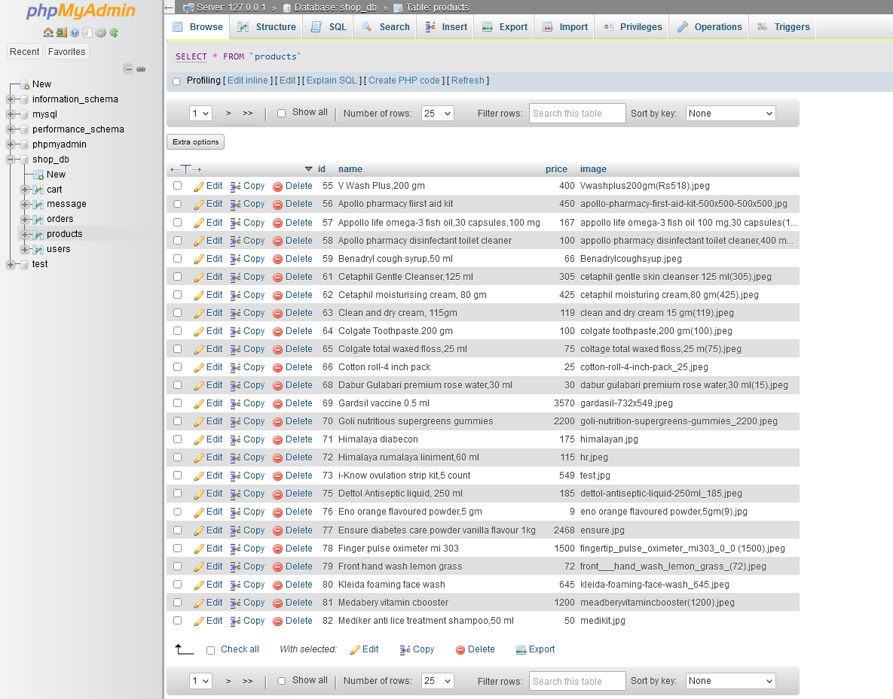

Slide 32
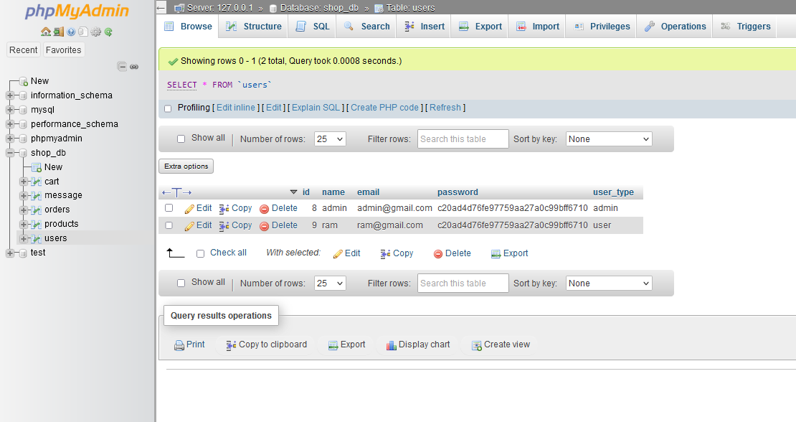

Slide 33
Future Enhancement
Integration with online wallets like E-sewa, Khalti, etc
Responsive website for multiple screens
Secure surfing in our website

Slide 34
CONCLUSION
User friendly Pharmacy Management System
Visually appealing system
CRUD operation of products through database
Reduction of manual workload

Slide 35
Thank You For Your Time!

